Slide 1
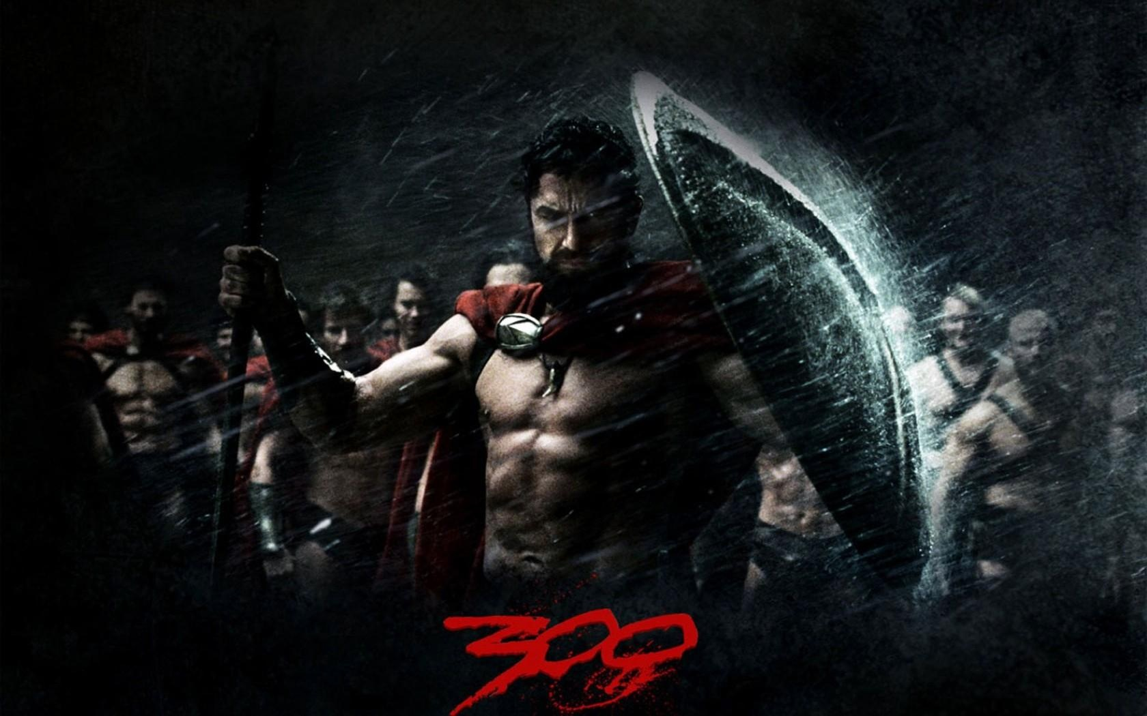
SPIRITUAL WARFARE,
INNER HEALING &
DELIVERANCE
THE BELIEVER’S AUTHORITY IN CHRIST

Slide 2
CAN A CHRISTIAN BE POSSESSED BY AN EVIL SPIRIT?
No. A Christian cannot be possessed because possession denotes ownership. Only God owns everything in this world. Demon spirits don’t own anything BUT they CAN “DEMONIZE” or OPPRESS people. Demons can INFLUENCE, DECEIVE, ATTACK, INVADE, and DESTROY a believer’s life.
Notes:
GREEK – DAIMONAIZOMAI – OPPRESSED BY DEMONS

Slide 3
THE CASE OF ANANIAS AND SAPPHIRA
Then Peter said, “Ananias, how is it that Satan has so FILLED your HEART that you have LIED to the Holy Spirit and have kept for yourself some of the money you received for the land?
ACTS 5:3 (NIV)
They were active believers but Satan has filled their hearts with lies when it came to money matters.

Slide 4
THE CASE OF THE DAUGHTER OF ABRAHAM
On a Sabbath Jesus was teaching in one of the SYNAGOGUES, and a woman was there who had been crippled by a spirit for eighteen years. She was bent over and could not straighten up at all. When Jesus saw her, he called her forward and said to her, "Woman, you are set free from your infirmity.” LUKE 13:10-12 (NIV)

Slide 5
THE CASE OF THE DAUGHTER OF ABRAHAM
Then should not this woman, a daughter of Abraham, whom Satan has kept bound for eighteen long years, be set free on the Sabbath day from what bound her?”
LUKE 13:16 (NIV)

Slide 6
THE DEVIL LOOKS FOR A VICTIM
Be alert and of sober mind. Your enemy the devil prowls around like a roaring lion LOOKING for someone to DEVOUR.
1 PETER 5:8 (NIV)
The devil is looking for someone he can swallow. That’s why Christians should be self-controlled and alert.

Slide 7
THE BATTLE WE FACE EVERYDAY
“For we do not WRESTLE against flesh and blood, but AGAINST PRINCIPALITIES, AGAINST POWERS, AGAINST the RULERS of the DARKNESS of this age, AGAINST SPIRITUAL HOSTS of WICKEDNESS in the heavenly places.”
EPHESIANS 6:12 NKJV
Notes:
LEVELS OF SPIRITUAL WARFARE
Ground Level Warfare - Low level demonic spirits
Occult Level Warfare - Agents of Satan
Strategic Level Warfare - Principalities, they control cities
WRESTLE: Hand to hand combat
AGAINST: Confrontation
PRINCIPALITIES: High ranking (General)
POWERS: Delegated authority
RULERS: {kosmokrateros}
Raw power put into order
POWERS - CAPTAINS
KOSMOKRATEROS- DISCIPLINE, ORGANIZATION, COMMITMENT.
*NOTE: SOMETIMES THIS IS MISSING IN THE CHURCH.
DEMONS SUBMIT TO EACH OTHER OUT OF FEAR...THEY FEAR PUNISHMENT FROM SATAN.
CHRISTIANS SUBMIT TO EACH OTHER OUT OF LOVE AND OBEDIENCE TO GOD.
SAD TO SAY MANY CHRISTIANS DO NOT SUBMIT TO THEIR LEADERS...
AUTHORITY AND POWER INCREASES AS WE LEARN TO SUBMIT TO OUR GOD-GIVEN LEADERS.
WE CANNOT SAY THAT WE ONLY SUBMIT TO GOD AND NOT TO OUR LEADERS...THAT IS UNBIBLICAL!
IT GOES AGAINST GOD'S WORD
READ:
OBEY THOSE WHO RULE OVER YOU, AND BE SUBMISSIVE, FOR THEY WATCH OUT FOR YOUR SOULS, AS THOSE WHO MUST GIVE ACCOUNT.
LET THEM DO SO WITH JOY AND NOT WITH GRIEF, FOR THAT WOULD BE UNPROFITABLE FOR YOU.
HEBREWS 13:17 NKJV
“But He gives more grace. Therefore He says: “God resists the proud, But gives grace to the humble.” Therefore submit to God. Resist the devil and he will flee from you.”
JAMES 4:6-7 NKJV
PEOPLE WHO DO NOT SUBMIT TO THEIR GOD GIVEN LEADERS DO NOT SUBMIT TO GOD.
THEY ARE NOT UNDER THE COVERING OR PROTECTION OF GOD. THEY ARE VULNERABLE TO SATANIC ATTACKS ESPECIALLY FROM DECEIVING SPIRITS.
EX.

Slide 8
THE IMPORTANCE OF SUBMISSION TO GODLY AUTHORITY
“OBEY those who rule over you, and BE SUBMISSIVE, for they watch out for your souls, as those who must give account. Let them do so with joy and not with grief, for that would be unprofitable for you.”
HEBREWS 13:17 NKJV
Notes:
N THE END, WE THINK WE ARE SUBMITTING TO GOD BUT IN TRUTH WE ARE OPPOSING HIM...
“But He gives more grace. Therefore He says: “God resists the proud, But gives grace to the humble.” Therefore submit to God. Resist the devil and he will flee from you.”
JAMES 4:6-7 NKJV

Slide 9
THE IMPORTANCE OF SUBMISSION TO GOD'S AUTHORITY
“But He gives more grace. Therefore He says: “God resists the proud, But gives grace to the humble.” Therefore SUBMIT to GOD. RESIST the DEVIL and he will flee from you.”
JAMES 4:6-7 NKJV
Notes:
PEOPLE WHO DO NOT SUBMIT TO THEIR GOD GIVEN LEADERS DO NOT SUBMIT TO GOD.
THEY ARE NOT UNDER THE COVERING OR PROTECTION OF GOD. THEY ARE VULNERABLE TO SATANIC ATTACKS ESPECIALLY FROM DECEIVING SPIRITS.
EX.

Slide 10
THE BIBLE SAYS THAT THERE ARE SPIRITUAL BEINGS
The SON is the IMAGE of the INVISIBLE GOD, the FIRSTBORN OVER ALL CREATION. For IN HIM ALL THINGS WERE CREATED: THINGS IN HEAVEN AND ON EARTH, VISIBLE AND INVISIBLE, whether THRONES or POWERS or RULERS or AUTHORITIES; ALL THINGS have been CREATED THROUGH HIM and FOR HIM. COLOSSIANS 1:15, 16 (NIV)

Slide 11
TWO SPIRITUAL KINGDOMS AT WAR
For he has rescued us from the DOMINION OF DARKNESS and brought us into the KINGDOM OF THE SON he loves. COLOSSIANS 1:13 (NIV)

Slide 12
THE DEVIL’S PLAN VS. GOD’S PLAN FOR MAN
The THIEF does not come except to STEAL, and to KILL, and to DESTROY. I HAVE COME that they may have LIFE, and that they may have it MORE ABUNDANTLY. JOHN 10:10 (NKJV)

Slide 13
THE DEVIL’S WORK
The god of this age has BLINDED the MINDS of UNBELIEVERS, so that they CANNOT SEE THE LIGHT of the GOSPEL that displays the GLORY OF CHRIST, who is the IMAGE of GOD. 2 CORINTHIANS4:4 (NIV)

Slide 14
THE DEVIL WANTS TO CONTROL US BUT JESUS WANTS TO HEAL US
How God anointed Jesus of Nazareth with the Holy Spirit and power, and how he went around doing good and healing all who were UNDER THE POWER OF THE DEVIL, because God was with him. ACTS 10:38 (NIV)

Slide 15
THE DEVIL’S DOORWAY IS SIN
“In your anger do not sin”: Do not let the sun go down while you are still angry, and DO NOT GIVE THE DEVIL A FOOTHOLD. EPHESIANS 4:26, 27 (NIV)

Slide 16
REPENTANCE IS NEEDED
Therefore CONFESS YOUR SINS to EACH OTHER and PRAY for EACH OTHER so that you may be HEALED. The PRAYER of a RIGHTEOUS PERSON is POWERFUL and EFFECTIVE. JAMES 5:16 (NIV)

Slide 17
JESUS CAME TO DESTROY THE DEVIL’S WORK
The one who does what is sinful is of the devil, because the devil has been sinning from the beginning. The reason the Son of God appeared was to DESTROY THE DEVIL’S WORK. 1 JOHN 3:8 (NIV)

Slide 18
JESUS GAVE US POWER AND AUTHORITY
“I have given you AUTHORITY to TRAMPLE on snakes and scorpions and to OVERCOME ALL THE POWER OF THE ENEMY; NOTHING WILL HARM YOU. However, do not rejoice that the spirits SUBMIT to you, but rejoice that YOUR NAMES are WRITTEN in HEAVEN.” LUKE 10:19, 20 (NIV)

Slide 19
DELIVERANCE IS A DAILY DUTY
“This, then, is HOW you should PRAY: “’Our Father in heaven, hallowed be your name, your kingdom come, your will be done, on earth as it is in heaven. Give us today our daily bread. And forgive us our debts, as we also have forgiven our debtors. And lead us not into temptation, but DELIVER us from the evil one.’” MATTHEW 6:9-13 (NIV)

Slide 20
GOD HAS GIVEN US KINGDOM AUTHORITY
“And as you GO, PREACH, saying, ‘The kingdom of heaven is at hand. ‘HEAL the sick, CLEANSE the lepers, RAISE the dead, CAST OUT demons. Freely you have received, freely give.” MATTHEW 10:7, 8 (NIV)

Slide 21
JESUS IS OUR MEDIATOR
For there is one God and one MEDIATOR between God and mankind, the man Christ Jesus. 1 TIMOTHY 2:5 (NIV)

Slide 22
JESUS IS OUR MEDIATOR
The next day John saw Jesus coming toward him and said, “Look, the Lamb of God, who takes away the sin of the world!” JOHN 1:29 (NIV)

Slide 23
JESUS IS LOOKING FOR INTERCESSORS
"I looked for someone among them who would build up the wall and stand before me in the gap on behalf of the land so I would not have to destroy it, but I found no one.” EZEKIEL 22:30 (NIV)

Slide 24
JESUS CONTINUES TO INTERCEDE FOR US IN HEAVEN
Therefore He is able also to save forever (completely, perfectly, for eternity) those who come to God through Him, since He always lives to intercede and intervene on their behalf [with God].
Hebrews 7:25 AMP

Slide 25
JESUS CAPTURED OUR SINS, OUR SICKNESS AND…
Surely he TOOK UP OUR PAIN and BORE OUR SUFFERING, yet we considered him punished by God, stricken by him, and afflicted. But he was pierced for OUR TRANSGRESSIONS, he was crushed for OUR INIQUITIES; the punishment that brought us PEACE was on him, and by his wounds we are HEALED. ISAIAH 53:4, 5 (NIV)

Slide 26
…OUR CURSE
CHRIST REDEEMED US from the CURSE of the law by BECOMING a CURSE for us, for it is written: “Cursed is everyone who is hung on a pole.” He REDEEMED US in order that the BLESSING given to Abraham MIGHT COME TO THE GENTILES THROUGH CHRIST JESUS, so that BY FAITH we might RECEIVE the PROMISE of the Spirit. GALATIANS 3:13, 14 (NIV)
Notes:
Many christians are not aware that they are under a curse.

Slide 27
OUR CURSE CAN COME FROM OUR ANCESTORS
“You shall not make for yourself an image in the form of anything in heaven above or on the earth beneath or in the waters below. You shall not bow down to them or worship them; for I, the LORD your God, am a jealous God, PUNISHING THE CHILDREN for the SIN OF THE PARENTS to the THIRD and FOURTH GENERATION of those who HATE ME.” EXODUS 20:4, 5 (NIV)

Slide 28
IN THIS WORLD WE ARE LIKE JESUS
“In this [union and fellowship with Him], love is completed and perfected with us, so that we may have confidence in the day of judgment [with assurance and boldness to face Him]; because as He is, so are we in this world.”
1 John 4:17 AMP
Notes:
“And from the days of John the Baptist until the present time, the kingdom of heaven has endured violent assault, and violent men seize it by force [as a precious prize–a share in the heavenly kingdom is sought with most ardent zeal and intense exertion].”
Matthew 11:12 AMPC
“From the moment John stepped onto the scene until now, the realm of heaven’s kingdom is bursting forth, and passionate people have taken hold of its power.”
Matthew 11:12 TPT

Slide 29
IN THIS WORLD WE ARE LIKE JESUS
“For he knew all about us before we were born and he destined us from the beginning to share the likeness of his Son. This means the Son is the oldest among a vast family of brothers and sisters who will become just like him.”
Romans 8:29 TPT
Notes:
“And from the days of John the Baptist until the present time, the kingdom of heaven has endured violent assault, and violent men seize it by force [as a precious prize–a share in the heavenly kingdom is sought with most ardent zeal and intense exertion].”
Matthew 11:12 AMPC
“From the moment John stepped onto the scene until now, the realm of heaven’s kingdom is bursting forth, and passionate people have taken hold of its power.”
Matthew 11:12 TPT

Slide 30
LIKE JESUS, WE CAPTURE THE ENEMY AND PLUNDER HIM
“But if it is by the Spirit of God that I drive out demons, then the kingdom of God has come upon you. “Or again, how can anyone enter a strong man’s house and carry off his possessions unless he first ties up the strong man? Then he can plunder his house.”
Matthew 12:28-29 NIV
Notes:
“And from the days of John the Baptist until the present time, the kingdom of heaven has endured violent assault, and violent men seize it by force [as a precious prize–a share in the heavenly kingdom is sought with most ardent zeal and intense exertion].”
Matthew 11:12 AMPC
“From the moment John stepped onto the scene until now, the realm of heaven’s kingdom is bursting forth, and passionate people have taken hold of its power.”
Matthew 11:12 TPT

Slide 31
CONFESS YOUR SIN TO REMOVE SICKNESS AND CURSE
If we claim to be without sin, we deceive ourselves and the truth is not in us. IF WE CONFESS OUR SINS, he is faithful and just and will forgive us our sins and purify us from all unrighteousness. If we claim we have not sinned, we make him out to be a liar and his word is not in us. 1 JOHN 1:8-10 (NIV)

Slide 32
A WORD OF WARNING
“When an unclean spirit goes out of a MAN, he goes through dry places, seeking rest, and finds none. Then he says, ‘I will return to my HOUSE from which I came.’ And when he comes, he finds it empty, swept, and put in order. Then he goes and takes with him seven other spirits more wicked than himself, and they enter and dwell there; and the last state of that man is worse than the first. So shall it also be with this wicked generation.” MATTHEW 12:43-45 (NKJV)
Notes:
(MSG) - V.25 ON RETURN, IT FINDS THE PERSON SWEPT AND DUSTED, BUT VACANT.

Slide 33
YOU ARE GOD’S TEMPLE
Do you not know that YOUR BODIES are TEMPLES of the HOLY SPIRIT, WHO IS IN YOU, whom you have received from God? YOU ARE NOT YOUR OWN; YOU were BOUGHT at a PRICE. Therefore HONOR GOD with YOUR BODIES. 1 CORINTHIANS 6:19, 20 (NIV)
Notes:
“Do two walk together unless they have agreed to do so?”
Amos 3:3 NIV

Slide 34
DO NOT BE QUICK TO SPEAK AGAINST THE MINISTRY OF GOD
“Therefore I say to you, every sin and blasphemy will be forgiven men, but the blasphemy against the Spirit will not be forgiven men. Anyone who speaks a word against the Son of Man, it will be forgiven him; but whoever speaks against the Holy Spirit, it will not be forgiven him, either in this age or in the age to come.” MATTHEW 12:31, 32 (NIV)

Slide 35
YOU CAN CAST OUT DEMONS BY THE HELP OF THE HOLY SPIRIT
“But if I am CASTING OUT DEMONS BY THE SPIRIT OF GOD, then the Kingdom of God has arrived among you. For who is powerful enough to enter the house of a strong man like Satan and plunder his goods? ONLY SOMEONE EVEN STRONGER—SOMEONE WHO COULD TIE HIM UP and then PLUNDER HIS HOUSE.”
MATTHEW 12:28, 29 (NIV)

Slide 36
GOD RENDERED DEMONIC FORCES POWERLESS
God STRIPPED the SPIRITUAL RULERS and POWERS of their AUTHORITY. With the cross, he won the victory and showed the world that they were POWERLESS.
COLOSSIANS 2:15 (NCV)

Slide 37
GOD HAS ALREADY JUDGED THE DEVIL
And the HELPER will PROVE to them that judgment happened when the RULER OF THIS WORLD WAS JUDGED.
JOHN 16:11 (NCV)

Slide 38
ARE YOU WORKING WITH GOD OR AGAINST GOD?
“Anyone who isn’t with me OPPOSES ME, and anyone who isn’t working with me is actually WORKING AGAINST ME.” MATTHEW 12:30 (NIV)

Slide 39
WEAR YOUR SPIRITUAL ARMOR DAILY
Finally, my brethren, be strong in the LORD and in the power of His might. PUT ON THE WHOLE ARMOR OF GOD, that you may be able to stand against the wiles of the devil. Therefore TAKE UP THE WHOLE ARMOR OF GOD, that you may be able to withstand in the evil day, and having done all, to stand. EPHESIANS 6:10, 11, 13 (NIV)

Slide 40
GEAR UP FOR THE BATTLE
WEAR THE HELMET OF SALVATION, BREASTPLATE OF RIGHTEOUSNESS, BELT OF TRUTH, SANDALS OF PEACE, SHIELD OF FAITH AND THE SWORD OF THE SPIRIT WHICH IS THE WORD OF GOD. EPHESIANS 6:14-18 (NIV)

Slide 41
NOTHING IS IMPOSSIBLE FOR THOSE WHO BELIEVE
“Most assuredly, I say to you, he who BELIEVES IN ME, THE WORKS THAT I DO HE WILL DO ALSO; and GREATER WORKS than these he will do, because I go to My Father. And WHATEVER YOU ASK IN MY NAME, THAT I WILL DO, that the Father may be glorified in the Son. IF YOU ASK ANYTHING IN MY NAME, I WILL DO IT.” JOHN 14:12-14 (NIV)

