Slide 1
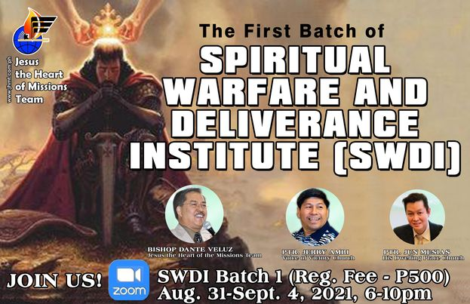

TUESDAY, August 31, 2019
By Bishop Dante Veluz

Slide 2

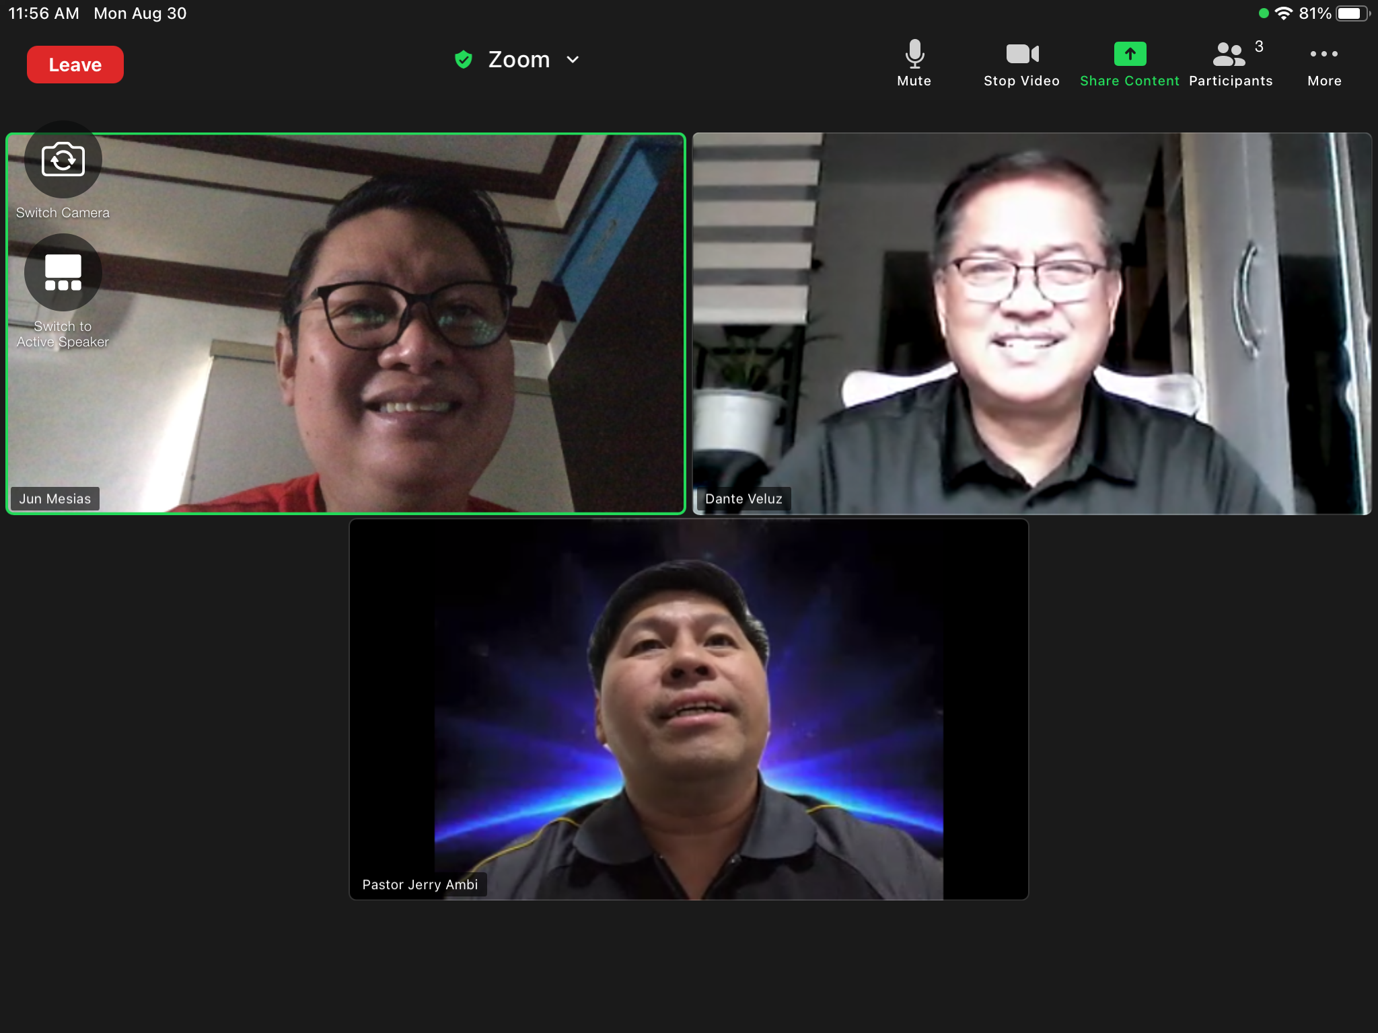
Monday, August 30, 2021, 11AM, via Zoom

Slide 3
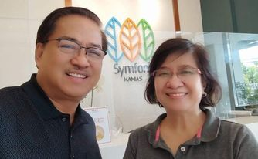

Slide 4
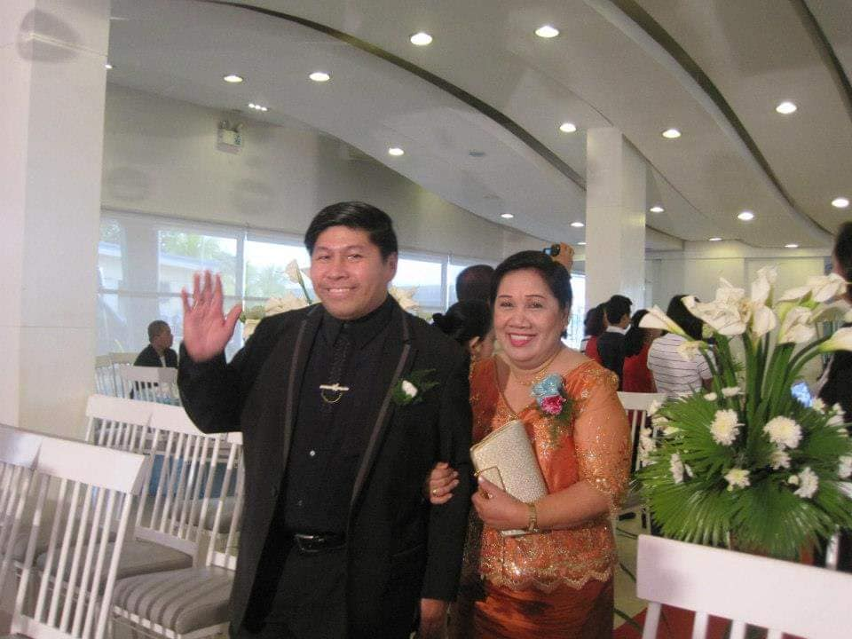

Slide 5
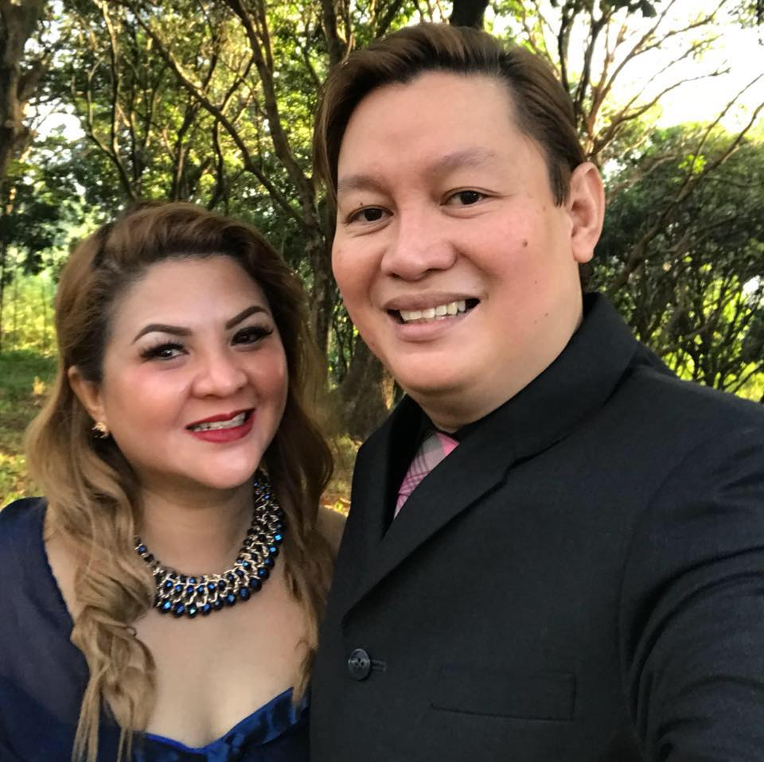

Slide 6
SPIRITUAL WARFARE & DELIVERANCE INSTITUTE (SWDI), 1ST BATCH
Aug 31-Sept 4, 2021 Tues-Sat, 6-10pm
1st Day, August 31, Tuesday
Establishing the Heart of a Warrior, Acts 13:22; 1 King 4:1-4; Dante Veluz
An Overview of the Spiritual Warfare & Deliverance, Luke 4:18-19; Ephesians 6:10-20, Romans 7:6-25, Dante Veluz
Character & Power Plumbline (Fear of God), Jerry Ambi
Activation: Personal Deliverance

Slide 7
2nd Day, September 1, Wednesday
Spiritual Beings, Cynthia Veluz
Identifying and Dealing with the Philippines and Overseas Principalities, Territorial Spirits, Rulers of Darkness and Wicked Spirits, Jerry Ambi
Activation: Mass Deliverance
Q & A Forum

Slide 8
3rd Day, September 2, Thursday
The Role of the Seers in Spiritual Warfare, Nenette Ambi (Cedric, etc)
Confronting The Principalities and Fallen Sons of God, Jerry Ambi
Ministering the 7 Last Days Anointing, Jerry Ambi
Q & A Forum

Slide 9
4th Day, September 3, Friday
Ministering Deliverance through The Courts of Heaven, Jun Mesias
"Capturing", Translation and Ministering to Heaven, Cristine Mesias
Video Presentation, Jun Mesias
Activation: Proxy or Capturing Deliverance
Q & A Forum

Slide 10
5th Day, September 4, Saturday
Levelling Up in Spiritual Warfare & Deliverance (Impartation), Part 1, JA
Levelling Up in Spiritual Warfare & Deliverance (Impartation), Part 2, JM
Maintaining Deliverance, DV
Closing: IMPARTATION & COMMISSIONING SERVICE

Slide 11
An Introduction to
Spiritual Warfare
& Deliverance
Notes:
AN Introduction to Spiritual Warfare & Deliverance

Slide 12
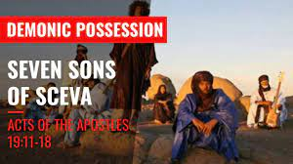
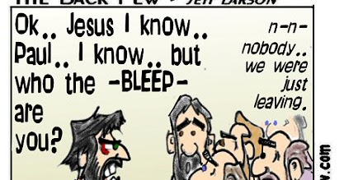
Notes:
AN Introduction to Spiritual Warfare & Deliverance

Slide 13
A bible School Student Dormer Possessed by demons, 1981
The Husband of My Former College Classmate in Salcedo Village Makati, 1992
Notes:
The Husband of My Former College Classmate in Salcedo Village Makati, 1992

Slide 14
^{Ephesians 6:10-18}
¹⁰ Finally, my brethren, be strong in the Lord, and in the power of his might.
¹¹ Put on the whole armour of God, that ye may be able to stand against the wiles of the devil.
¹² For we wrestle not against flesh and blood, but against principalities, against powers, against the rulers of the darkness of this world, against spiritual wickedness in high places.
¹³ Wherefore take unto you the whole armour of God, that ye may be able to withstand in the evil day, and having done all, to stand.

Slide 15
¹⁴ Stand therefore, having your loins girt about with truth, and having on the breastplate of righteousness;
¹⁵ And your feet shod with the preparation of the gospel of peace;
¹⁶ Above all, taking the shield of faith, wherewith ye shall be able to quench all the fiery darts of the wicked.

Slide 16
¹⁷ And take the helmet of salvation, and the sword of the Spirit, which is the word of God:
¹⁸ Praying always with all prayer and supplication in the Spirit, and watching thereunto with all perseverance and supplication for all saints;
¹⁹ And for me, that utterance may be given unto me, that I may open my mouth boldly, to make known the mystery of the gospel,
²⁰ For which I am an ambassador in bonds: that therein I may speak boldly, as I ought to speak.

Slide 17
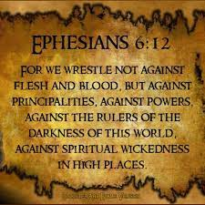

Slide 18
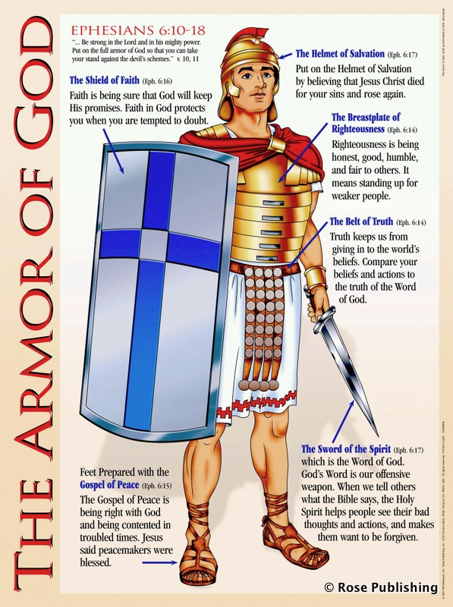

Slide 19
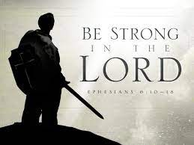

Ephesians 6:10
¹⁰ Finally, my brethren, be strong in the Lord, and in the power of his might.

Slide 20

During an altar call at a former theater in San Pablo City, 1995
Notes:
During an altart call at a former theater in San Pablo City, 1995

Slide 21
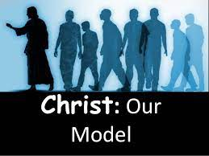
Notes:
During an altart call at a former theater in San Pablo City, 1995

Slide 22

Matthew 4:1-11
4 Then Jesus was led by the Spirit into the wilderness to be tempted by the devil. ² After fasting for forty days and forty nights, he was hungry. ³ The tempter came to him and said, ‘If you are the Son of God, tell these stones to become bread.’ ⁴ Jesus answered, ‘It is written: “Man shall not live on bread alone, but on every word that comes from the mouth of God.”
Live a
Spirit-led Life
Notes:
1. Spirit-led Life

Slide 23
Matthew 4:1-11
4 Then Jesus was led by the Spirit into the wilderness to be tempted by the devil. ² After fasting for forty days and forty nights, he was hungry. ³ The tempter came to him and said, ‘If you are the Son of God, tell these stones to become bread.’ ⁴ Jesus answered, ‘It is written: “Man shall not live on bread alone, but on every word that comes from the mouth of God.”
2. Adopt a Prayer
& Fasted Life
Notes:
2. Living a Prayer & Faster Life

Slide 24
Matthew 4:1-11
4 Then Jesus was led by the Spirit into the wilderness to be tempted by the devil. ² After fasting for forty days and forty nights, he was hungry. ³ The tempter came to him and said, ‘If you are the Son of God, tell these stones to become bread.’ ⁴ Jesus answered, ‘It is written: “Man shall not live on bread alone, but on every word that comes from the mouth of God.”
3. Be Grounded
on God’s Word
Notes:
3. Grounded on God’s Word

Slide 25
⁸ Again, the devil took him to a very high mountain and showed him all the kingdoms of the world and their splendor. ⁹ ‘All this I will give you,’ he said, ‘if you will bow down and worship me.’ ¹⁰ Jesus said to him, ‘Away from me, Satan! For it is written: “Worship the Lord your God, and serve him only.”
¹¹ Then the devil left him, and angels came and attended him.
4. Make Worship a Lifestyle
Notes:
4. Lived A Lifestyle of Worship

Slide 26
⁸ Again, the devil took him to a very high mountain and showed him all the kingdoms of the world and their splendor. ⁹ ‘All this I will give you,’ he said, ‘if you will bow down and worship me.’ ¹⁰ Jesus said to him, ‘Away from me, Satan! For it is written: “Worship the Lord your God, and serve him only.”
¹¹ Then the devil left him, and angels came and attended him.
5. Ministered by
God’s Angels
Notes:
4. Lived A Lifestyle of Worship

Slide 27
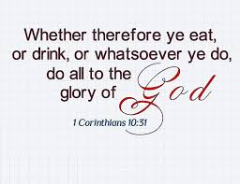

Slide 28
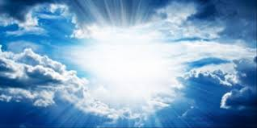

To
God
be the glory!

Slide 29


Slide 30

Notes:
During an altart call at a former theater in San Pablo City, 1995

Slide 31
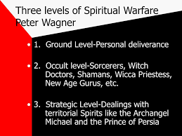
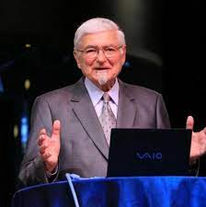
Encounter with demons
Notes:
Encounter with demons

Slide 32

Notes:
During an altart call at a former theater in San Pablo City, 1995

Slide 33
1. Demon Possession(Ground Level Encounters
Lumban Bible Church, Wife of member, August 30, 1999
Husband of former College Classmate in Salcedo Village, Makati, December, 1992
Notes:
Principalities Encounters Villasis UMC Camp, April, 1999, Word of Hope – Tanay, Rizal, May 27,1999

Slide 34
Notes:
During an altart call at a former theater in San Pablo City, 1995

Slide 35
2. Occult Level Encounters
Prayer Caravan: 3 Witchcrafts places in Siquijor Island, April, 1997
Prayer Caravan at PBMA Headquarters, Holy Land, San Jose, Dinagat Island, April, 1997
Notes:
Principalities Encounters Villasis UMC Camp, April, 1999, Word of Hope – Tanay, Rizal, May 27,1999

Slide 36
Notes:
During an altart call at a former theater in San Pablo City, 1995

Slide 37
3. Principalities Encounters (Strategic Level)
Villasis, Pangasinan
UMC Camp, 100 pax, May, 1999
Youth Camp, 250 pax, Word of Hope, QC
Joseph Estrada Camp Site, Tanay, Rizal,
May 27, 1999
Notes:
Principalities Encounters Villasis UMC Camp, April, 1999, Word of Hope – Tanay, Rizal, May 27,1999

Slide 38
Principalities Encounters
Redeeming the Land Warfare, Vietnam and Cambodia, October, 1998
Notes:
Principalities Encounters Villasis UMC Camp, April, 1999, Word of Hope – Tanay, Rizal, May 27,1999

Slide 39
Principalities Encounters
Haunted House, Philadelphia, Pennsylvania, USA, 2004
Notes:
Principalities Encounters Villasis UMC Camp, April, 1999, Word of Hope – Tanay, Rizal, May 27,1999

Slide 40
Notes:
During an altart call at a former theater in San Pablo City, 1995

Slide 42
To
God
be the glory!

Slide 44

Notes:
During an altart call at a former theater in San Pablo City, 1995

Slide 45

Notes:
During an altart call at a former theater in San Pablo City, 1995

Slide 46
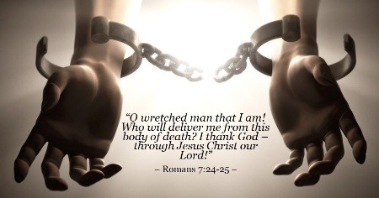
Notes:
During an altart call at a former theater in San Pablo City, 1995

Slide 47


Slide 48

Winning
Notes:
Using A Deliverance Form and administered by someone

Slide 49


Slide 50
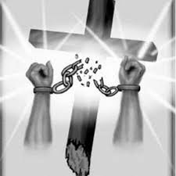


Slide 51

1. TRUTH Encounter
Using A Deliverance Form and administered by someone
Notes:
Using A Deliverance Form and administered by someone

Slide 52


2. POWER Encounter
Moving in Revelation Warfare with Signs, Wonders & Miracles
Notes:
Using A Deliverance Form and administered by someone

Slide 53
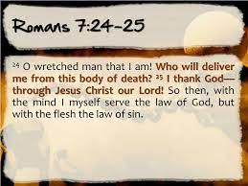
3. PERSONAL Encounter
DELIVERANCE by personal decision through REPENTANCE
Notes:
Using A Deliverance Form and administered by someone

Slide 54
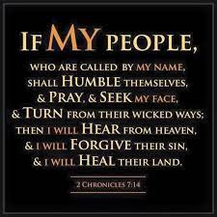
Notes:
Using A Deliverance Form and administered by someone

Slide 55
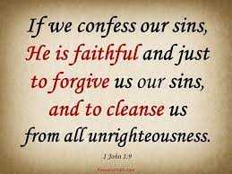
Notes:
Using A Deliverance Form and administered by someone

Slide 56
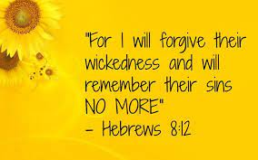
Notes:
Using A Deliverance Form and administered by someone

Slide 57
4. THE COURTS OF HEAVEN
Encounter
Through Prayer Submission / Petition
(to be discussed this week)
Notes:
Using A Deliverance Form and administered by someone

Slide 58
5. CAPTURING Deliverance
Encounter
Through PROXY deliverance
(to be discussed this week)
Notes:
Using A Deliverance Form and administered by someone

Slide 59
6. 7 LAST DAYS ANOINTING Deliverance
Encounter
Through THE 7 Powerful Keys of warfare and deliverance
(to be discussed this week)
Notes:
Using A Deliverance Form and administered by someone

Slide 61
To
God
be the glory!

